Slide 1

The Confidentialisation Reinvigoration
How confidentiality is incorporated in Statistic NZ’s strategic intentions 2016/17-19/20
Alistair Ramsden, Statistical Analyst
November 2016
Notes:
The Confidentialisation Reinvigoration
- How confidentiality is incorporated within Statistic NZ’s strategic intentions 2016/17-19/20 - selected Confidentiality related quotes from the Statistics NZ annual report and statement of intent published in October 2016.
- This is a know-about paper, not a know-how paper. It won't tell people how to confidentialise, but it will tell people about why we confidentialise, and where this is made explicit in our high level strategy documents, i.e. in our annual report / statement of intent / four year plan.
- I’m also intrigued by statements by reliable senior academic authorities on statistics, concerning how stewardship and confidentiality are identical, and what this potentially mean for us in our context.
Compiled by Alistair Ramsden, Statistical Analyst, 27 October 2016
Source: http://www.stats.govt.nz/about_us/what-we-do/our-publications/annual-reports/annual-report-2016.aspx
Source: Statistics NZ PowerPoint presentation September 2015 – teal (A138147) = Notes://DRDOMMAIL01/CC2574AC0081F71D/F6E01B6BE8D67A1ACC256E8B001C6868/CC8B527A82F7F3BACC257EC3007D97AE
Source: http://images.hngn.com/data/thumbs/full/132373/650/0/0/0/the-big-bang-theory.png

Slide 2
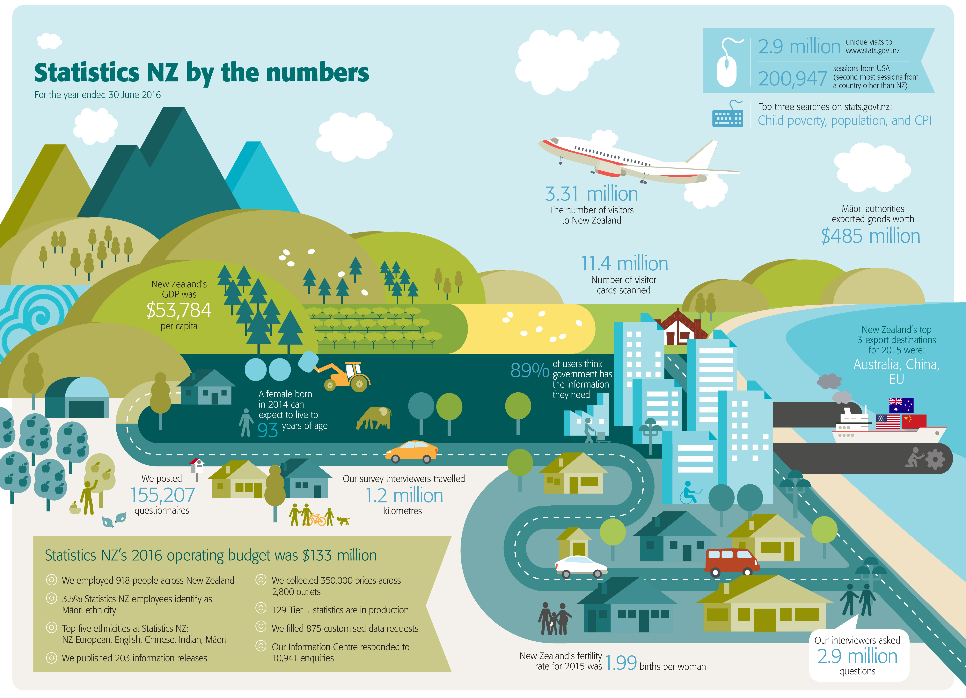
Statistics NZ's strategic intentions for the period 2016/17–19/20
see also: http://www.stats.govt.nz/about_us/what-we-do/our-publications/annual-reports/annual-report-2016.aspx
Notes:
Statistics New Zealand's Strategic intentions for the period 2016/17–19/20 Annual report for the year ended 30 June 2016
Source: http://www.stats.govt.nz/about_us/what-we-do/our-publications/annual-reports/annual-report-2016.aspx
Statistics New Zealand's Strategic intentions for the period 2016/17–19/20 Annual report for the year ended 30 June 2016 (PDF, 88 pages, 2.73MB)
Statistics NZ by the numbers for the year ending 30 June 2016 (jpg, 3.4Mb) (3.21MB)
Statistics New Zealand's Strategic intentions for the period 2016/17–19/20 Annual report for the year ended 30 June 2016
brings together our 2015/16 annual report and our 2016/17–19/20 strategic intentions into one document.
This new format allows us to tell a continuous story about our performance and intentions, enabling a clear performance narrative that is connected to our future focus.
Statistics New Zealand (2016). Statistics New Zealand's Strategic intentions for the period 2016/17–19/20 Annual report for the year ended 30 June 2016.
Wellington: Statistics New Zealand. Published 19 October 2016

Slide 3

Accessible, usable, valuable data
open data model will need to be provided in an integrated, robust, and safe environment
to protect the privacy and confidentiality of individuals and businesses
while enabling more people and organisations to supply and access data as it is needed through multiple digital channels
Notes:
1. (p.10) Accessible, usable, valuable data
[...]
In a world of ever-increasing changes in the pace and amount of data being collected and sought, we envisage that, as a system, New Zealand will need a ‘national data exchange’ model. In this model, flexible infrastructure supports supply and retrieval of data, so the value of the data can be unleashed at points and in forms not currently available. This open data model will need to be provided in an integrated, robust, and safe environment to protect the privacy and CONFIDENTIALITY of individuals and businesses, while enabling more people and organisations to supply and access data as it is needed through multiple digital channels.

Slide 4

Social licence
proliferation of personal data across the data ecosystem
giving rise to questions about citizens’ privacy and confidentiality
Notes:
2. (p.14) Social licence
[...]
The proliferation of personal data across the data ecosystem is giving rise to questions about citizens’ privacy and CONFIDENTIALITY. A tension exists between the needs of decision-makers to generate insights at much deeper levels than ever before to solve systemic problems – such as the current focus on eliminating child poverty – and the desire of individuals to have their rights and privacy maintained. Our brand as trusted and independent remains strong, and is a foundation that allows us to be successful. However, as we increasingly provide new data-related services, we will need to ensure that we (and the data ecosystem as a whole) maintain our social licence as a trusted steward of the nation’s data and information.
***
Source: https://business-humanrights.org/sites/default/files/images/The-Social-License-John-Morrison.jpg

Slide 5
More data is available than ever before
questions are also being asked about the quality of this data
and how to manage it so insights can be harnessed
while balancing privacy and confidentiality requirements and individuals’ desire for control over their own data
Notes:
3. (p.14) More data is available than ever before
[...]
Data is growing exponentially. This has the opportunity to provide greater insights to decision-makers than ever before. Paradoxically, it is increasingly difficult to access the rich information that sits within increasingly larger datasets. Questions are also being asked about the quality of this data and how to manage it so insights can be harnessed, while balancing privacy and CONFIDENTIALITY requirements and individuals’ desire for control over their own data. Decision-makers are increasingly looking to us to provide leadership and advice on:
* reusing data where possible
* promoting cooperation in data storage
* leading the development of data capability
* providing data integration
* ensuring that New Zealand’s data management and practices are world leading.

Slide 6
Part of our strategic functions
optimise our preparation of data
to ensure it remain in as natural state as possible
yet is fit for purpose, usable, visible, accessible, and confidential
Notes:
4. (p.21) Our strategic functions
[...]
The strategic functions describe how Statistics NZ will engage with the data ecosystem and give effect to our roles.
[...]
Circling the central core are the strategic functions ‘source’, ‘shape’, ‘enrich’, and ‘sustain’. Through these functions we will efficiently reuse our data assets and access data collected by others to:
* minimise burden, maintain supply, and ensure one source of truth
* optimise our preparation of data to ensure it remain in as natural state as possible yet is fit for purpose, usable, visible, accessible, and CONFIDENTIAL
* enrich New Zealand’s most important data and provide quality insights in ways that are meaningful to our customers
* conserve and optimise data and statistics as strategic assets so they retain their value and are accessible – now and in the future.
(Note: Data ecosystem = all of the data and its suppliers and users in New Zealand (p.10))
***
Here’s a further relevant quote from:
Duncan, G.T., Elliot, M. and Salazar-González, J.-J. Springer 2011. Statistical confidentiality. Principles and practice. Retrieved from http://link.springer.com/book/10.1007%2F978-1-4419-7802-8.
(page vi) “So what exactly is statistical confidentiality? Simply put, it is the stewardship of data to be used for statistical purposes. Stewardship, as expressed in statistical confidentiality, is an active embrace of responsibility for both protecting data and ensuring its beneficial use. Explicitly it requires proper practices for both providing and restricting access to data products.”
I’m particularly intrigued by senior academic authorities on statistics (George T. Duncan is an Emeritus Professor of Statistics with 40 years of tenure at Carnegie Mellon University Pennsylvania), whom we rely upon (e.g. in Statistics NZ guidance on confidentiality lodged with ict.govt.nz in 2012), declaring an identity between stewardship and confidentiality.
See also: http://www.heinz.cmu.edu/faculty-and-research/faculty-profiles/faculty-details/index.aspx?faculty_id=33
See also: https://www.ict.govt.nz/assets/Uploads/Documents/W1248475-StatsNZConfidentialityGuidance.pdf

Slide 7
One of our decision-making principles
Trust and security will remain paramount to the [data] ecosystem
data ecosystem = all of the data and its suppliers and users in New Zealand
paramount = more important than anything else; supreme; having supreme power
Notes:
5. (p.23) Figure 6: Our decision-making principles
[...]
*** TRUST
** Trust and security will remain paramount to the [data] ecosystem
* Are we protecting business IN-CONFIDENCE information sufficiently?
* Are we sharing the data safely?
(Note: Data ecosystem = all of the data and its suppliers and users in New Zealand (p.10))
(Note: Paramount = more important than anything else; supreme; having supreme power. (Google))
(Note: Trust relates to social licence; security relates to privacy, confidentiality and security)

Slide 8
Underpinning our target operating model
Legislation will support an “open data first” approach, covering:
security, privacy and confidentiality,
access to quality admin data,
and sharing of data.
see also: https://www.ict.govt.nz/programmes-and-initiatives/open-and-transparent-government/open-government-information-and-data-work-programm/
Notes:
6. (p.24) Figure 7: Our target operating model
[...]
Authorising environment – Legislation will support an “open data first” approach, covering security, privacy and CONFIDENTIALITY, access to quality admin data, and sharing of data. Our social licence will allow us to protect and release data.
***
see also: https://www.ict.govt.nz/programmes-and-initiatives/open-and-transparent-government/open-government-information-and-data-work-programm/
The programme aims to:
* make non-personal government-held data and information more widely available and discoverable, easily usable and compliant with open government data principles within the NZ legal context; and
* facilitate agencies’ release of the non-personal government-held data and information that people, communities, and businesses want to use and re-use.

Slide 9
Among of our core offerings
Data services:
We collect data, clean it,
de-identify and confidentialise it,
and make it available to the New Zealand public.
Notes:
7. (p.25) Figure 8: Our core offerings
[...]
[2] Data services: we provide data in various forms, from untouched to highly enriched. We collect data, clean it, de-identify and CONFIDENTIALISE it, and make it available to the New Zealand public. We guide customers, intermediaries, suppliers, partners and stakeholders to other data sources. We provide regulation for the New Zealand data ecosystem.

Slide 10
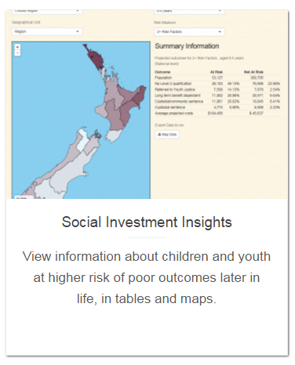
E.g. within the social investment insights tool
As well as meeting user needs
this tool maintains individual privacy and confidentiality
– thereby maintaining trust with the public over the use of their information.
see also: http://innovation.stats.govt.nz/initiatives/social-investment-insights/
Notes:
8. (p.45) Social investment insights [tool]
[...]
We have worked closely with the Treasury to develop Social Investments Insights. The aim of this tool is to make complex data more easily accessible, so it can be used to inform timelier and better-targeted services. The online tool and analysis reports have been made possible through the Integrated Data Service.
[...]
The tool takes complex and sensitive data and provides it in a format which easy to use, fast, free, and interactive. As well as meeting user needs, this tool maintains individual privacy and CONFIDENTIALITY – thereby maintaining trust with the public over the use of their information.

Slide 11
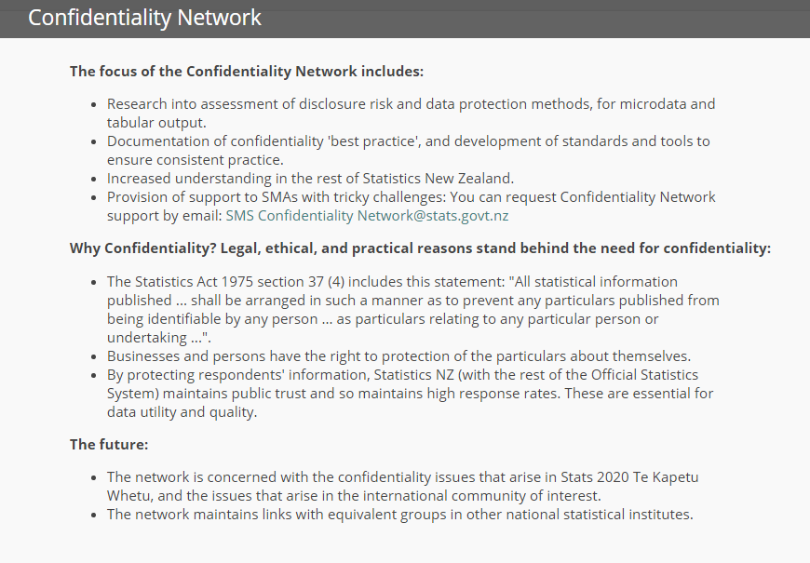
Would you like to know more?
see also: http://tematapihi.stats.govt.nz/AreaHomepagesFolder/Confidentiality%20Network.aspx
Notes:
Would you like to know more?
Join the Confidentiality Network
The focus of the Confidentiality Network includes:
* Research into assessment of disclosure risk and data protection methods, for microdata and tabular output.
* Documentation of confidentiality 'best practice', and development of standards and tools to ensure consistent practice.
* Increased understanding in the rest of Statistics New Zealand.
* Support for SMAs
Source: http://tematapihi.stats.govt.nz/AreaHomepagesFolder/Confidentiality%20Network.aspx

Slide 12

Questions?
Notes:
Source: https://si.wsj.net/public/resources/images/BN-KP082_NUMBER_J_20151002110316.jpg

